Slide 1

InstaCart Market Basket Analysis
Data Management and Big Data
Prof. Jamie Warner
Labdhi Ghelani
Mohita Sharma
Nikhil Kamath
Pranav Gudipally

Slide 2
Agenda Style
01
Introduction
02
Business Questions
03
Recommendation Engine
04
Conclusion

Slide 3
Business Questions
Introduction

Slide 4
Selection of Data
Criteria
The dataset that we have selected is an open sourced data available by Instacart sourced
from Kaggle, to mainly predict what products people will repurchase in their next order.
The data set is split into separate csv files(the users, orders, products in each orders, department names) such as we can visualize informative features which are User specific, Product Specific and User-Product Relationship.
Orders: 3 million orders. Includes user ID, product bought, order of purchase, time of order, and whether each product was previously purchased by that user.
Users: About 200,000. Only user ID’s given.
Products: About 50,000 products available for purchase from Instacart, along with aisle and department identifiers

Slide 5
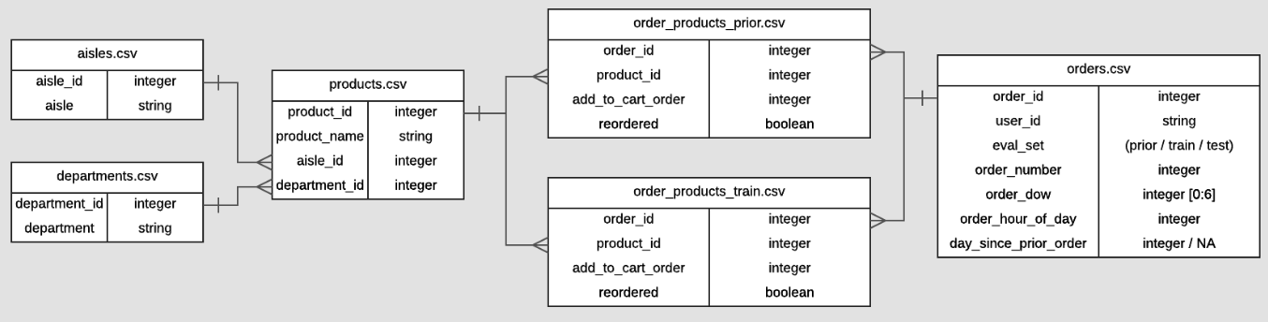
Relationship between Instacart data files
DBMS Diagram

Slide 6
Business Questions
Business Questions

Slide 7

Business Questions
Reordering frequency distribution by days since prior order
Top 10 highest selling products
Reorder ratio for day of the week vs hour of the day
During what time of that day do people order the highest selling products?
Top 5 users with their departmental purchases
On which day do people order the highest selling products?

Slide 8
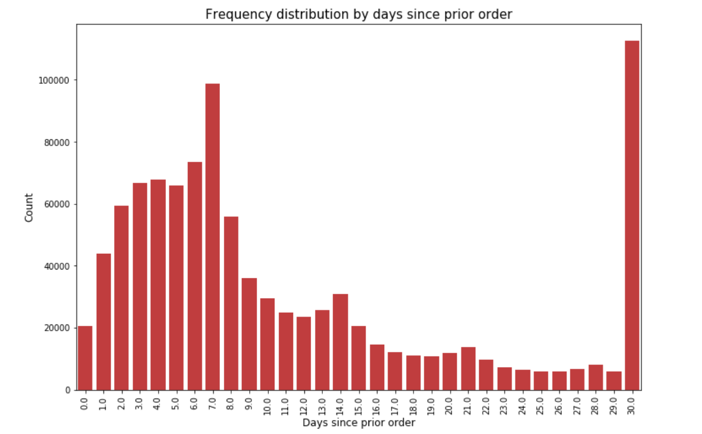
Reordering frequency distribution by days since prior order
Looking at the bar chart we can deduce that the
Customers order every once a week or once a month.
(Peaks on the 7th and 30th
days of the month).
We can also see similar
smaller peaks at 14th, 21st
and 28th days of the month.
(Weekly intervals)

Slide 9
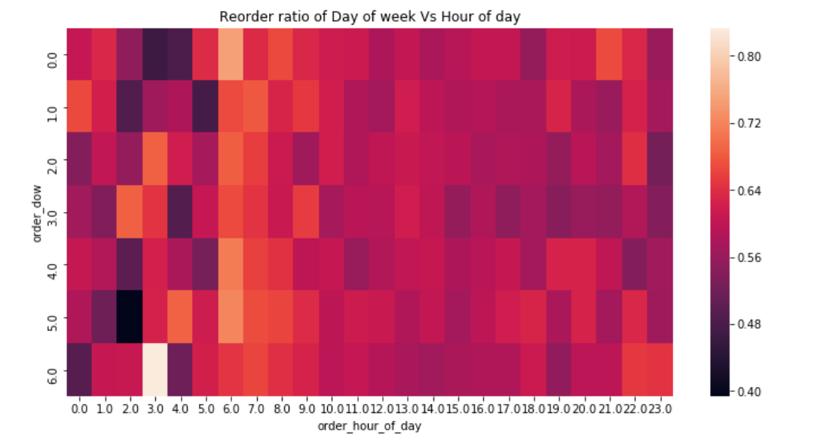
Reorder ratio for day of the week vs hour of the day
The heatmap shows that the reorder ratio were quite high during early mornings as
compared to the later half of the day.

Slide 10
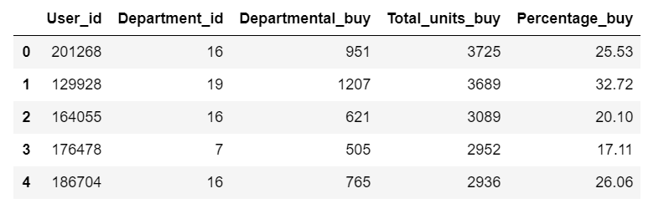
Tabular Analysis of top 5 users with their departmental purchases
The table depicts the top 5 users buys from a given Department(Department_id, Departmental_buy) out of the total units bought across all departments(Total_units_buy)
and the percentage of products purchased from a particular department.

Slide 11
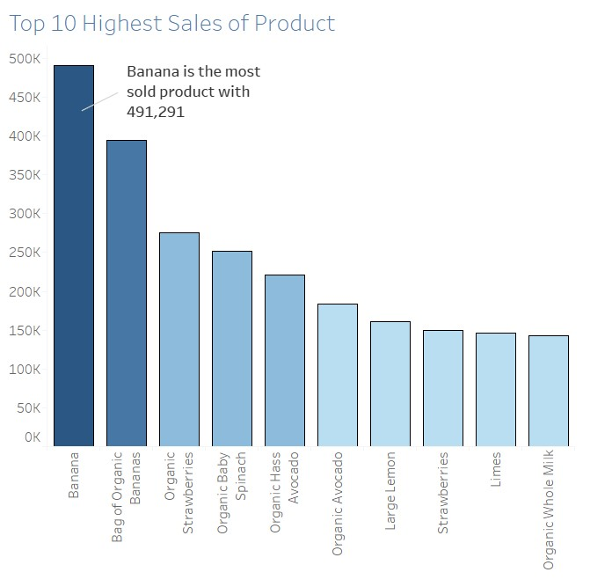
Top 10 highest products sold
According to our analysis, Bananas was the highest
sold product with quantity
491,291 followed by Bag of Organic Bananas, Organic Strawberries and Organic Baby Spinach.
Hence, we can infer that
Organic products are sold most often and majority of
them are fruits.

Slide 12
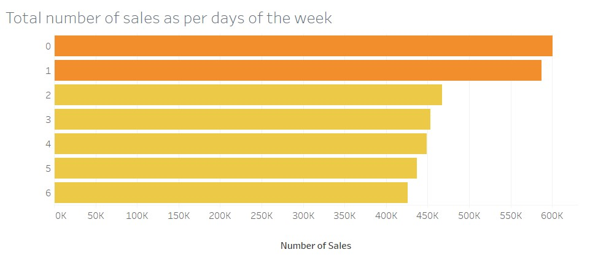
On which day do people order the highest selling products?
It seems like the Total Sales during the week were
Highest on 0 and
1 when most of the meal planning for the given week occurs. (Assuming it as weekends)
Also it can be noticed that
Orders placed were
observed the least on
6 which marks the end of the working week and
people want to relax during the weekends.

Slide 13
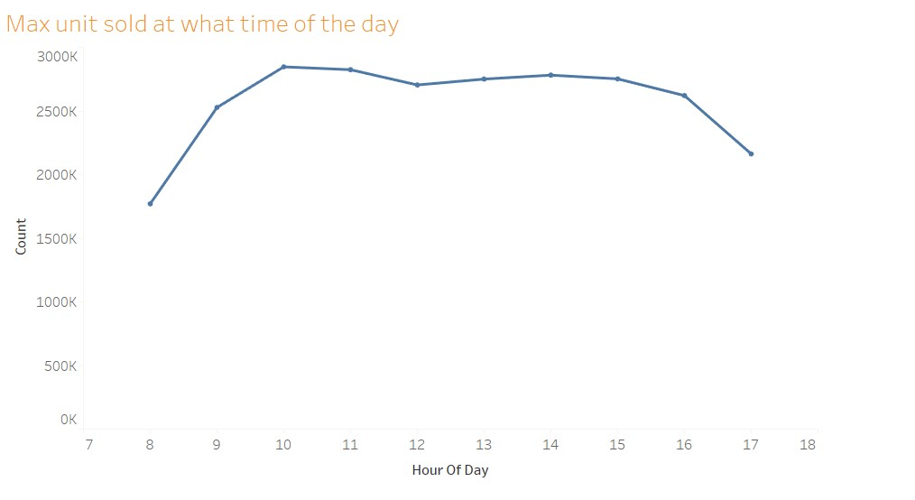
During what time of the day do people order the most?
As observed,
the majority of the orders were placed during the
day time at 10 am when
most of the people begin
their day and meal
preparation before leaving for work as opposed to
The least orders placed
were at 6pm when people are returning back from
work.

Slide 14
Business Questions
Recommendation Engine

Slide 15
Recommendation Engine
PROPOSED SYSTEM
Our aim is to maximize the sale of the products, we have decided to build the recommendation engine
which would recommend products to a user based on their previous purchase
Overall, to increase the sales of Market Basket, a recommendation engine can also recommend items to a user which are most popular among users of same type.
We have followed the given steps: 1]Recommendation based on the historical purchases of the top user
2]Recommendation of products based on similar inter departmental products based on their choice from the top department (Content based recommendation)
3]Recommendation based on direct exit to cart checkout

Slide 16
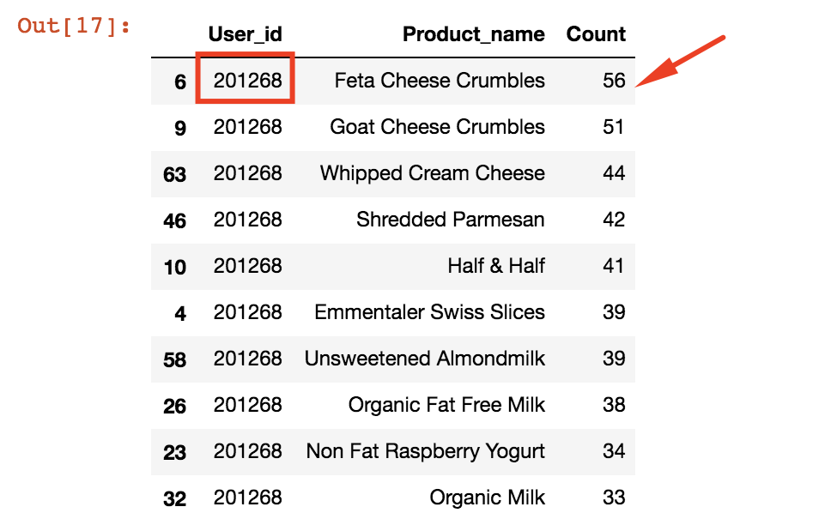
Recommendation based on the historical purchases of the top user

Slide 17
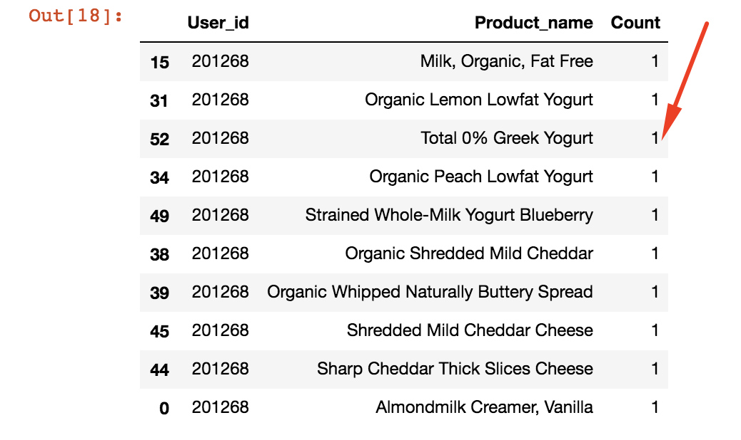
Recommendation of products based on similar inter departmental product
based on their choice from the top department.
(Content based recommendation)

Slide 18
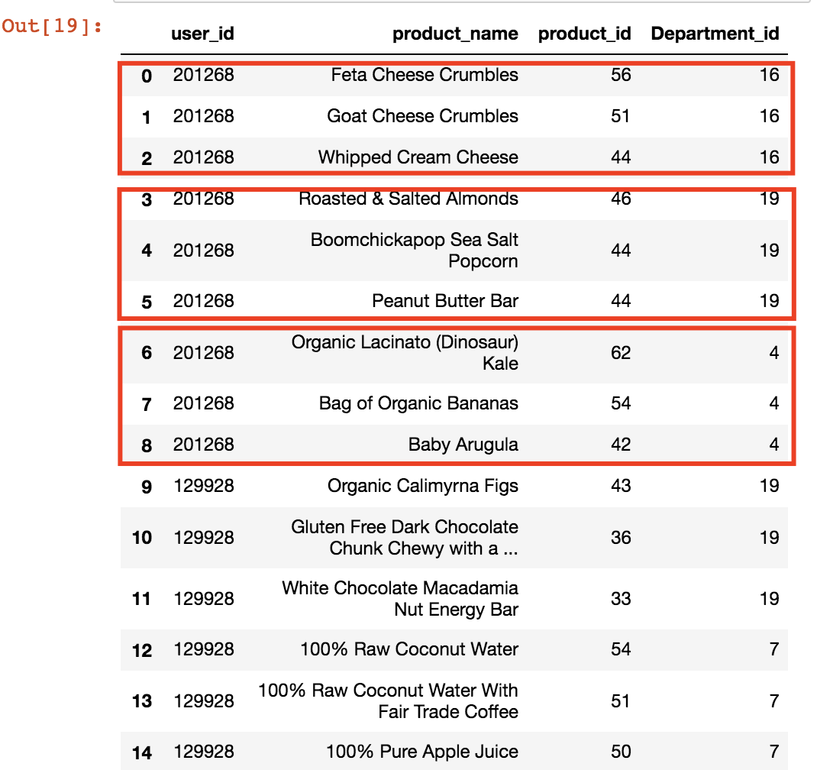
Recommendation based on direct exit to cart checkout

Slide 19
Conclusion
Based on the given recommendation engine, the business(Instacart) can retain
their top loyal consumers. By providing recommendation based on their previous
interests.
Effective recommendations are a valuable service to the customers and a profitable service to the retailer.
The data analysis done, will help the retailers to maintain their Profit and Sales,
thereby maintaining their existing customers taking into account the key analyses.

